Slide 1
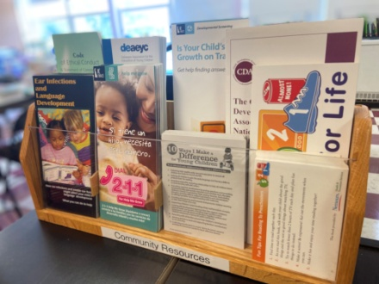
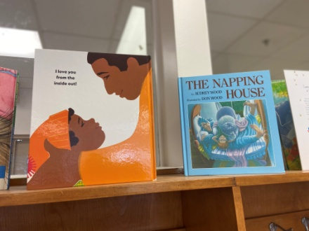
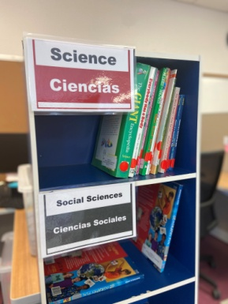
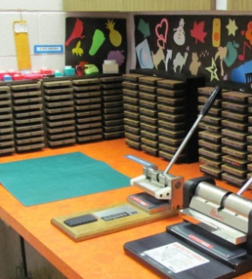
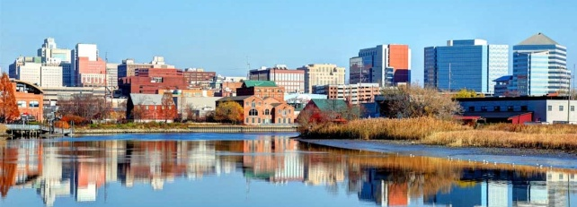
Do you have a personal or professional interest in the future success of Wilmington’s youngest children?
Attend a WECEC meeting to find out how you can contribute to the fulfillment of our mission!
Meetings are scheduled for the third Thursday of most months from 9:00 - 11:00 am (currently via Zoom), when in person, at the City of Wilmington Parks and Recreation Building 500 Wilmington Road, Wilmington, DE 19801.
For further information about WECEC, please email Lynn Jezyk, Executive Administrative Assistant at lejezyk@wilmingtonde.gov .
Little Kids, Big Plans
Operating in
cooperation with
and funded by:
The City of Wilmington
and
WECEC Professional Development Resource Center
wececresourcecenter@gmail.com
Stubbs Early Education Center
1100 North Pine Street
Wilmington , DE 19801
Office of Early Learning
Notes:
To change this brochure, replace our sample content with your own. Or, if you'd rather start from a clean slate, press the New Slide button on the Home tab to insert a new page. Now enter your text and pictures in the empty placeholders. If you need more placeholders for titles, subtitles or body text, copy any of the existing placeholders, then drag the new one into place.

Slide 2
Who We Are
WECEC Professional Development Resource Center
Our Mission
WECEC currently receives funding from the City of Wilmington and the State of Delaware Department of Education, Office of Early Learning to operate a Professional Development Resource Center currently located at Stubbs Early Education Center. The goal of the Center is to increase the quality of early care and education experiences for young children in the City of Wilmington by offering the following services to individuals who live or work in Wilmington Zip Codes 19801, 19802, 19805(city limits) and 19806:
The mission of WECEC is that all Wilmington children will have access to an integrated early childhood system which fosters collaboration among existing programs, and identifies gaps in the current delivery system for children birth through 8 years old.
Bringing Unity Between
Resources and Community
The Wilmington Early Care and Education Council ( WECEC) was created in 2001 with the support of then Mayor Baker. Wilmington City Council passed an ordinance establishing the WECEC as part of the Wilmington Advisory Commission on Youth and their Families in 2006. Membership includes early childhood educators, parents, local community organizations, City school districts, City charter schools, institutions of higher learning with early childhood education programs, resource and referral agency and representatives from the Office of the Mayor, Office of Early Learning, Office of the City Council, Office of Child Care Licensing and the Division of Social Services.
Knowledge of the services offered by the agencies of other WECEC members leads to the formation of collaborative relationships that help children and families take full advantage of the services being offered in the City of Wilmington community. As a Council, we use this knowledge to identify gaps in services that currently exist in our community and strive to create supportive bridges.
WECEC Professional Development Resource Center
Patti Lynch, Coordinator
Stubbs Early Education Center, Room 203
1100 North Pine St.
Wilmington, DE 19801
wececresourcecenter@gmail.com
Lending library with educational books, variety of curriculum kits, teaching tools (including bilingual resources), and curriculum & administrative reference books
Laminating, photocopying, book binding, die-cut machines, and computer use on-site
Scholarships for professional development training preparing for the CDA, Child Development Associate including Training for Early Care and Education (TECE) 1 & 2 and Quality Assist Quorum
Quality training opportunities
Career advisement and professional development guidance
Transitional assistance with higher education
Technical assistance and mentoring
Community resource referrals
If you would like to utilize the resources at the WECEC PDRC, please email Patti at
wececresourcecenter@gmail.com to schedule time during the hours of operation.
Interested in WECEC Scholarships for professional development training preparing for the CDA?
Email: wececscholarship@gmail.com
Hours of Operation:
Monday: 10:00 am-1:00 pm
Tuesday: 3:30 pm-8:00 pm
Wednesday 10:00 am- 1:00 pm
Thursday: 3:30 pm- 8:00 pm
Friday: Center Closed for Community Outreach
Little Kids, Big Plans
rev. 08.28.2022

